Slide 1
TA 7
Generic programming – void* and pointer to function

Slide 2
Generic programming with void*

Slide 3
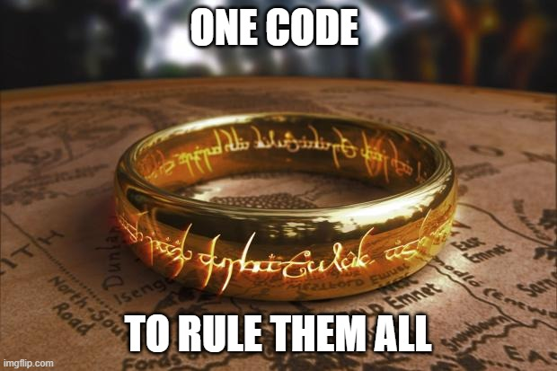
Generic programming
The goal – write code that works for many data types, without code duplication
In C, can be achieved in 2 ways:
void* - pointer to any data type
pointer to functions
Notes:
פוינטר שאין לו טייפ שמקושר אליו ויכול להחזיק כל סוג

Slide 4
Generic programming using void*
void* can point to any data type
No pointer arithmetic
No dereferencing
int main() { int a[] = {5, 2}; float b = 5.3; void *p = &b; p = a; printf("%d", *p); // compilation error printf("%p", p + 1); // compiles, // not allowed by C standard - GCC extension
printf("%d", *((int*) p)); // compiles and runs return 0; }
Notes:
GCC allows void* arithmetic, but it is not OK according to the C standard
אם

Slide 5
Generic programming using void*
void* can point to any data type
No pointer arithmetic
No dereferencing
int main() { int a[] = {5, 2}; float b = 5.3; void *p = &b; p = a; printf("%d", *p); // compilation error printf("%p", p + 1); // compiles, // not allowed by C standard - GCC extension
printf("%d", *((int*) p)); // compiles and runs return 0; }
Notes:
GCC allows void* arithmetic, but it is not OK according to the C standard
אם

Slide 6
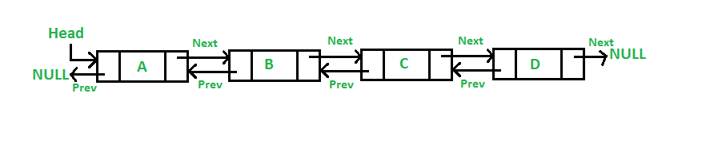
Generic programming using void* - doubly linked list
We will now implement part of a generic doubly linked list using void*
Node *newNode(void *data) { Node *newNode = (Node *) malloc(sizeof(Node)); newNode->next = NULL; newNode->prev = NULL; newNode->data = data; return newNode; }
int insertNode(Node **head_arg, void *data) { if (head_arg == NULL) { return 0; } Node *node = newNode(data); if (* head_arg == NULL) { *head = node; return 1; } node->next = *head; (*(*head)).prev = node;
*head = node; return 1; }
typedef struct Node { Node* next; Node* prev; void* data; } Node;

Slide 7
Generic programming using void* - doubly linked list
For deletion, we can get a Node* to delete, oblivious to the internals of the node
int removeNode(Node **head, Node *toRemove) { if (head == NULL || *head == NULL || toRemove == NULL) { return 0; } Node *curNode = *head; while (curNode != toRemove && curNode != NULL) { curNode = curNode->next; } if (curNode == NULL) // not found { return 0; }
if (curNode->prev == NULL) // head { *head = curNode->next; return 1; } if (curNode->next == NULL) // tail { curNode->prev->next = NULL; return 1; } curNode->prev->next = curNode->next; curNode->next->prev = curNode->prev; return 1; }

Slide 8
Generic programming using void* - doubly linked list
For deletion, we can get a Node* to delete, oblivious to the internals of the node
int removeNode(Node **head, Node *toRemove) { if (head == NULL || *head == NULL || toRemove == NULL) { return 0; } Node *curNode = *head; while (curNode != toRemove && curNode != NULL) { curNode = curNode->next; } if (curNode == NULL) // not found { return 0; }
if (curNode->prev == NULL) // head { *head = curNode->next;
free(toRemove); return 1; } if (curNode->next == NULL) // tail { curNode->prev->next = NULL;
free(toRemove); return 1; } curNode->prev->next = curNode->next; curNode->next->prev = curNode->prev;
free(toRemove); return 1; }

Slide 9
Pointer to function

Slide 10
Pointers to Functions
DATA
stack
The function code is written in code segment, unlike other variables which
stored in the data segment.
The address of a functions is where the function code begins.
heap
int foo() { //.... } int main(int argc, char *argv[]) { foo(); //…… }
static
global
CODE
main
foo

Slide 11
Pointers to Functions
In C, we can have pointers to function - pointers which stores the address of a function.
Meaning, points to the start of the function code.
A function pointer always points to a function with a specific signature! Thus all functions, you want to use with the same function pointer, must have the same parameters and return-type!
We declare a function pointer as follows:
func_ptr is
a pointer
to a function
that gets two integers
and returns an integer
return
value
name
arguments
int (* func_ptr) (int, int);
int (* func_ptr) (int, int);
int (* func_ptr) (int, int);
int (* func_ptr) (int, int);
int (* func_ptr) (int, int);
int (* func_ptr) (int, int);

Slide 12
Pointers to Functions
DATA
Stack
A function’s name can also be used to get functions’ address.
func_ptr
int foo(int a, int b) { int res = a + b; return res; } int main(int argc, char *argv[]) { int (*func_ptr)(int, int) = &foo; // func_ptr points to foo int (*func_ptr)(int, int) = foo; // the same //…… int func_return = (*func_ptr)(10, 12); // calling foo using func_ptr int func_return2 = func_ptr(10, 12); // the same }
heap
static
global
CODE
main
foo

Slide 13
Pointers to Functions Declaration Example
What’s the meaning of following declaration in C language?
void *(*f)(int, void(*)());
f is pointer to a function which returns nothing and receives as its parameters an integer and a pointer to a function which receives nothing and returns a void pointer
f is a pointer to a function which returns a void pointer and receives as its parameters an integer and a pointer to a function which receives nothing and returns a void pointer
f is a function which returns a pointer to void pointer and receives as its parameters an integer and a pointer to a function which receives undefined num of parameters and returns a void pointer
f is a pointer to a function which returns void pointer and receives as its parameters an integer and a pointer to a function which receives undefined num of parameters and returns nothing

Slide 14

Return Function Pointer
Like any other variables, we can return pointers to function from a function.
void (*draw(int shape))(int){ if (shape == 1) { return &drawCircle; } else if (shape == 2) { return &drawSquare; } else { return &drawLine; } } int main() { void (*ptr)(int); ptr = draw(2); ptr(4); }
draw is
a function
that gets an integer
and returns a pointer
to a function
that gets an integer
and returns nothing
void drawCircle(int diameter) { //... } void drawSquare(int side) { //... } void drawLine(int length) { //... }

Slide 15
Return Function Pointer
typedef void (*drawPtr)(int);
void (*draw(int shape))(int){ if (shape == 1) { return &drawCircle; } else if (shape == 2) { return &drawSquare; } else { return &drawLine; } } int main() { void (*ptr)(int); ptr = draw(2); ptr(4); }
Use typedef!
drawPtr draw(int shape){ if (shape == 1) { return &drawCircle; }
else if (shape == 2) { return &drawSquare; } else { return &drawLine; } }
int main() { drawPtr ptr; ptr = draw(2); ptr(4); }
void drawCircle(int diameter) { //... } void drawSquare(int side) { //... } void drawLine(int length) { //... }

Slide 16
Quick Sort
The standard library function qsort is a generic function to sort an array:
void qsort(void* base, size_t num, size_t size, int(*comparator)(const void*, const void*))
void qsort(void* base, size_t num, size_t size, int(*comparator)(const void*, const void*))
void qsort(void* base, size_t num, size_t size, int(*comparator)(const void*, const void*))
void qsort(void* base, size_t num, size_t size, int(*comparator)(const void*, const void*))
void qsort(void* base, size_t num, size_t size, int(*comparator)(const void*, const void*))
start of the array to be sorted
size of array element
number of elements in the array
Pointer to the comparison function:
Returns an integer less than, equal to, or greater than zero if the first argument is considered to be respectively less than, equal to, or greater than the second

Slide 17
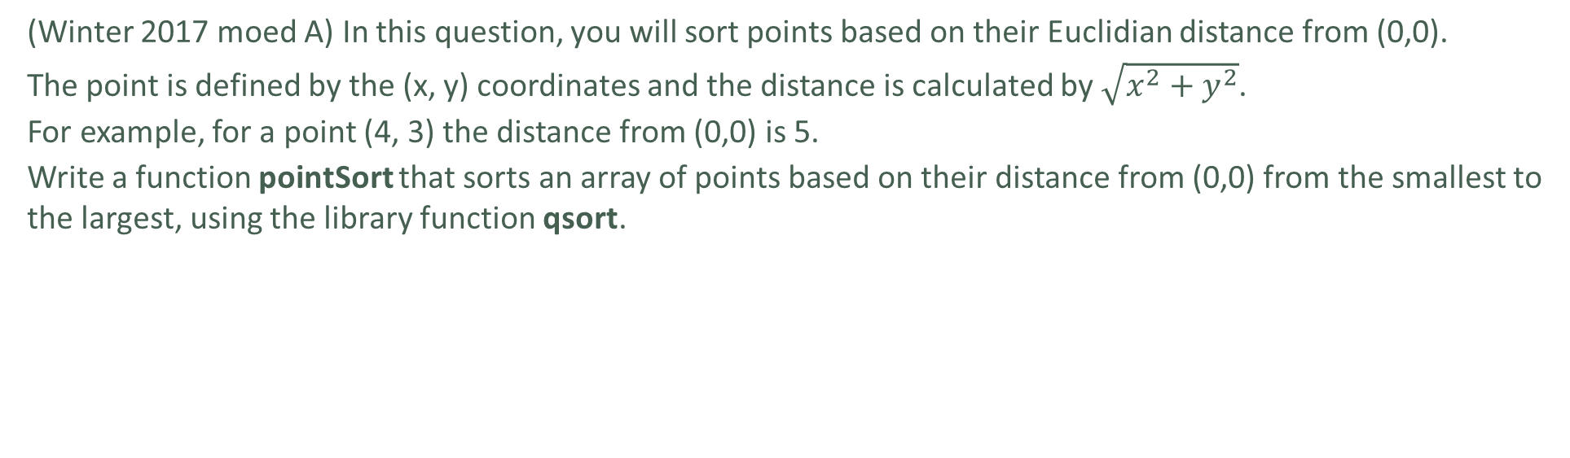
Points Sorting
(Winter 2017 moed A) In this question, you will sort points based on their Euclidian distance from (0,0).
The point is defined by the (x, y) coordinates and the distance is calculated by $\sqrt{x^{2}+y^{2}}$.
For example, for a point (4, 3) the distance from (0,0) is 5.
Write a function pointSort that sorts an array of points based on their distance from (0,0) from the smallest to the largest, using the library function qsort.
typedef struct Point { int x; int y; } Point;
void pointSort(Point *pointArray, unsigned int tSize) {
}
Notes:
- Code runner
- If necessary, emphasize that the comparison should not be implemented with a square root

Slide 18
Points Sorting
qsort accepts a pointer to a function that gets two const void*, so we must follow that signature when we implement our own compare function
int compareFunc(const void *p1, const void *p2) { const Point *pt1 = (const Point *) p1; const Point *pt2 = (const Point *) p2; int d1 = pt1->x * pt1->x + pt1->y * pt1->y; int d2 = pt2->x * pt2->x + pt2->y * pt2->y; return (d1 - d2); } void pointSort(Point *pointArray, unsigned int tSize) { qsort(pointArray, tSize, sizeof(Point), compareFunc); }

Slide 19
Generic BST

Slide 20
Generic programming using void* - BST
Let’s say we want to implement a generic binary search tree. We can start with
Node *newNode(void *data) { Node *newNode = (Node *) malloc(sizeof(Node)); newNode->left = NULL; newNode->right = NULL; newNode->data = data; return newNode; }
typedef struct Node { struct Node *left; struct Node *right; void *data; } Node;

Slide 21
Generic programming using void* - BST
int int_insert(Node **root, void *data) { if (*root == NULL) { *root = newNode(data); return 1; } int intData = *((int *) data); int curData = *((int *) ((*root)->data)); if (intData == curData) { return 0; } else if (intData < curData) { return int_insert(&((*root)->left), data); } else { return int_insert(&((*root)->right), data); } }
We would like now to have a function that inserts new data to the BST.
But, for this we need to be able to compare between the data of the nodes
This requires us to write such a function for every datatype we’ll use with our BST

Slide 22
int int_insert(Node **root, void *data) { if (root == NULL) { return 0; } if (*root == NULL) { *root = newNode(data); return 1; } int intData = *((int *) data); int curData = *((int *) ((*root)->data)); if (intData == curData) { return 0; } else if (intData < curData) { return int_insert(&((*root)->left), data); } else { return int_insert(&((*root)->right), data); } }
int char_insert(Node **root, void *data) { if (root == NULL) { return 0; } if (*root == NULL) { *root = newNode(data); return 1; } char charData = *((char *) data); char curData = *((char *) ((*root)->data)); if (charData == curData) { return 0; } else if (charData < curData) { return char_insert(&((*root)->left), data); } else { return char_insert(&((*root)->right), data); } }
int main() { Node *intRoot = NULL; int x = 1, y = 2; int intRes1 = int_insert(&intRoot, &x); int intRes2 = int_insert(&intRoot, &y); Node *charRoot = NULL; char a = 'a', b = 'b'; int charRes1 = char_insert(&charRoot, &a); int charRes2 = char_insert(&charRoot, &b); }

Slide 23
Generic programming using void*
When we encounter such a problem, we usually choose to use pointers to function
For example, in the case of BST, imagine you could “remember” what function you need for the type of data really in the Node* and apply it when necessary
If you had a BST with int* data – the code will “remember” to use the int* version, if you had a BST with double* data – the code will “remember” to use the double* version etc.

Slide 24
int insert(Node **root, void *data, int (*comparator)(const void *, const void *)) { if (root == NULL) { return 0; } if (*root == NULL) { *root = newNode(data); return 1; } int res = comparator(data, (*root)->data); if (res == 0) { return 0; } else if (res < 0) { return insert(&((*root)->left), data, comparator); } else { return insert(&((*root)->right), data, comparator); } }
int compareInt(const void *a, const void *b) { const int i1 = *(const int *) a; const int i2 = *(const int *) b; return i1 - i2; } int compareChar(const void *a, const void *b) { const char c1 = *(const char *) a; const char c2 = *(const char *) b; return c1 - c2; } int main() { Node *intRoot = NULL; int x = 1, y = 2; int intRes1 = insert(&intRoot, &x, compareInt); int intRes2 = insert(&intRoot, &y, compareInt); Node *charRoot = NULL; char a = 'a', b = 'b'; int charRes1 = insert(&charRoot, &a, compareChar); int charRes2 = insert(&charRoot, &b, compareChar); }
Pointer to the comparison function:
Returns an integer less than, equal to,
or greater than zero if the first argument
is considered to be respectively less than, equal to, or greater
than the second

